Slide 1
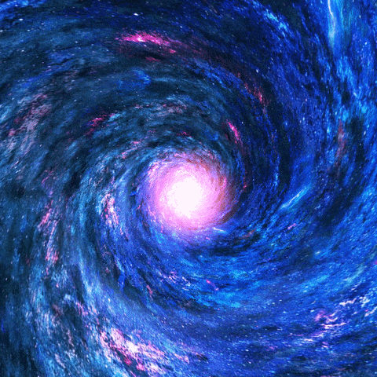
Advance
Fibonacci

Slide 2
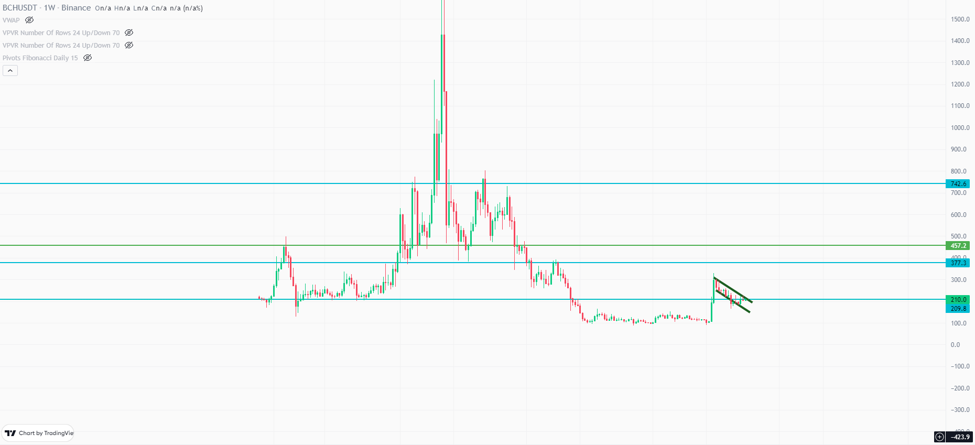
Fibonacci Channel

Slide 3
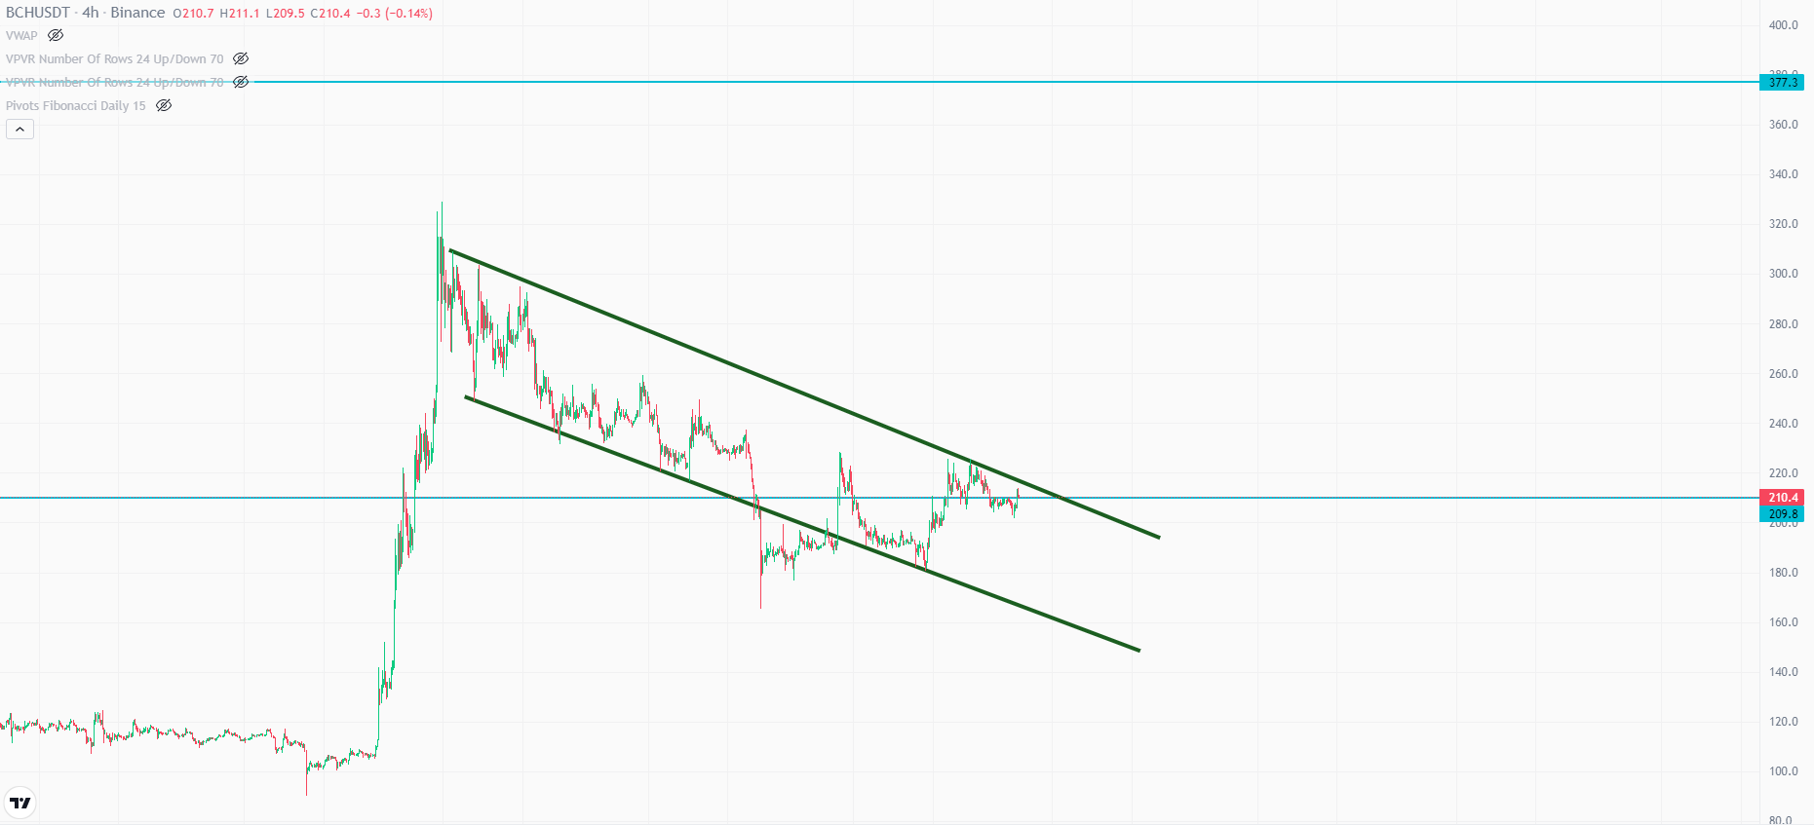
Fibonacci Channel

Slide 4
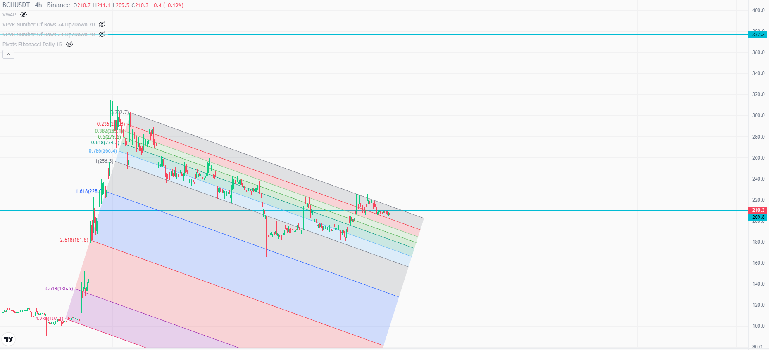
Fibonacci Channel

Slide 5
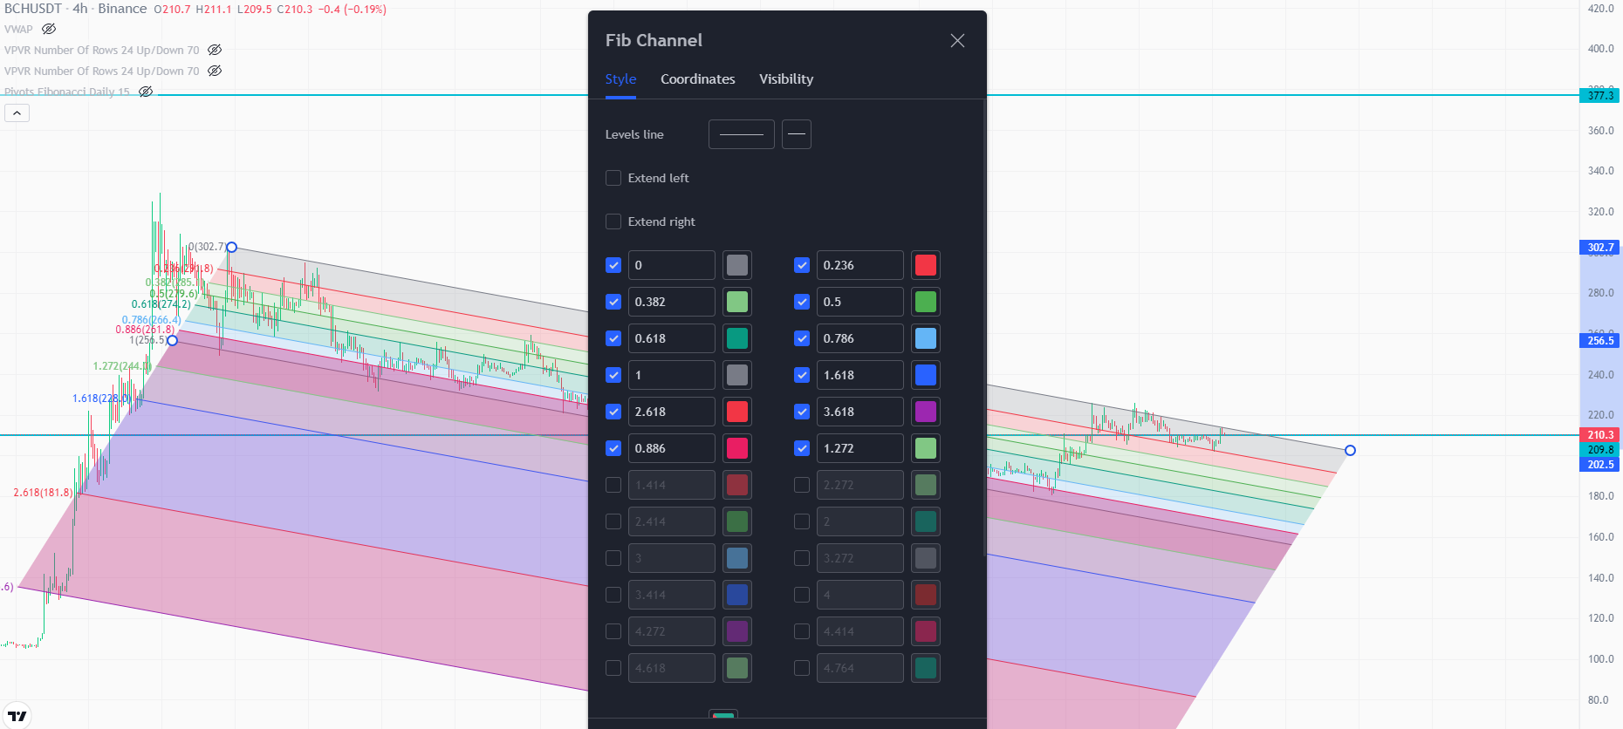
Fibonacci Channel

Slide 6
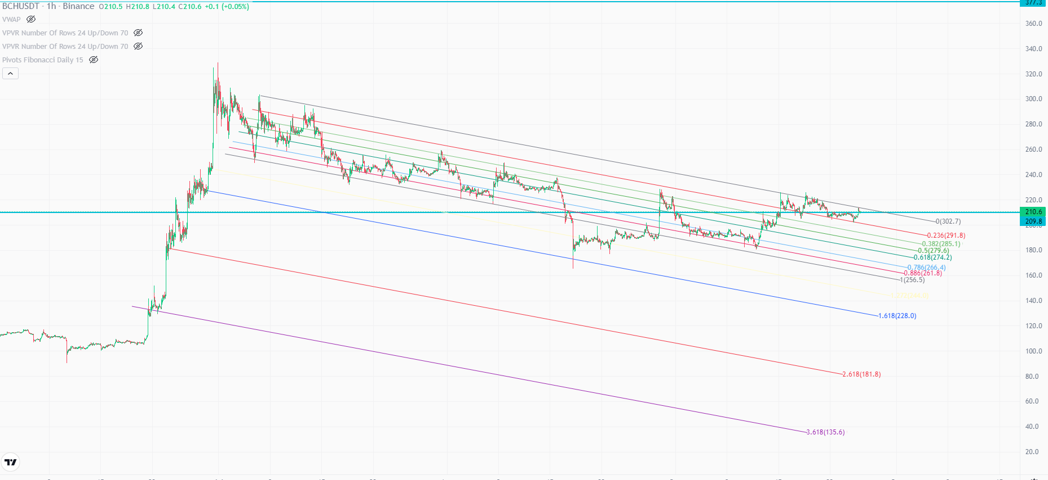
Fibonacci Channel

Slide 7
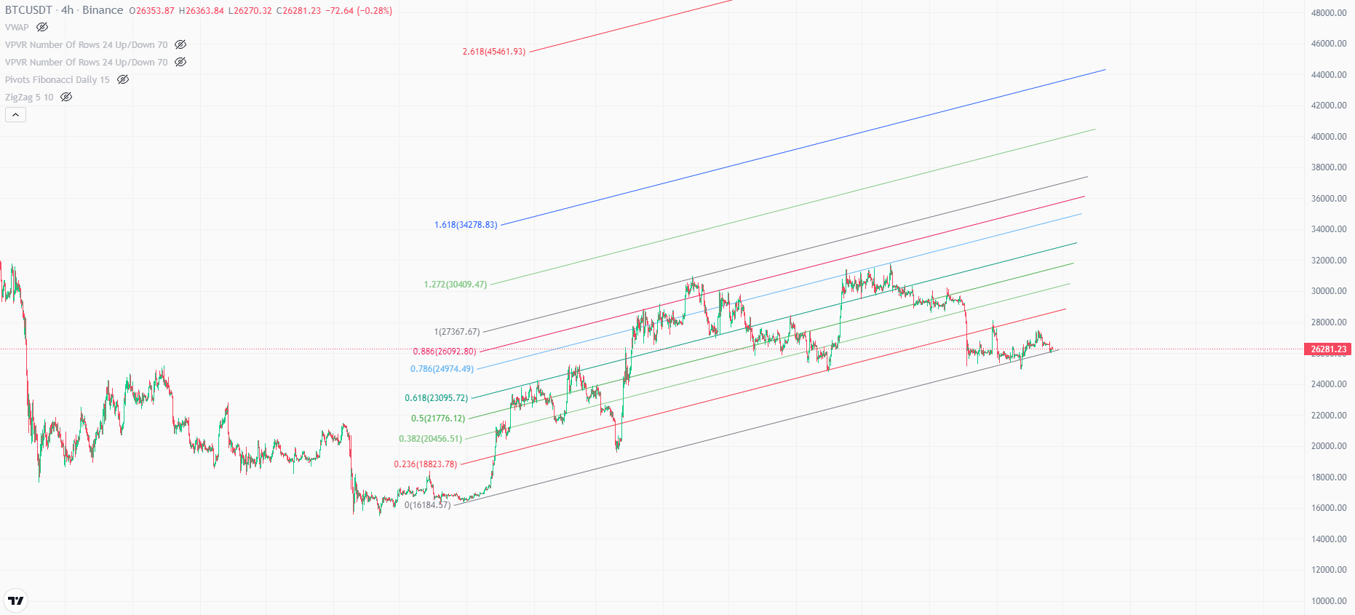
Fibonacci Channel

Slide 8
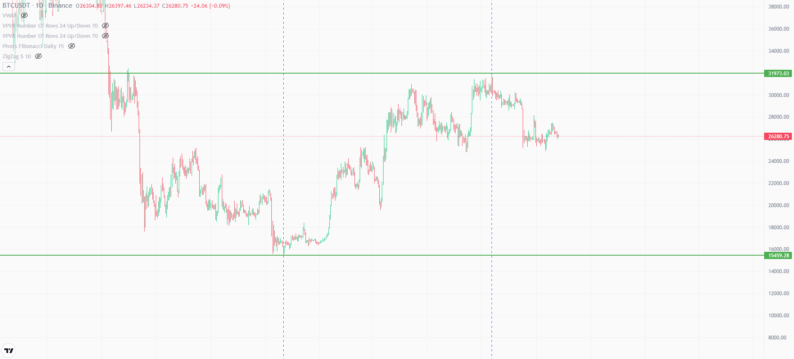
Fibonacci Arc

Slide 9
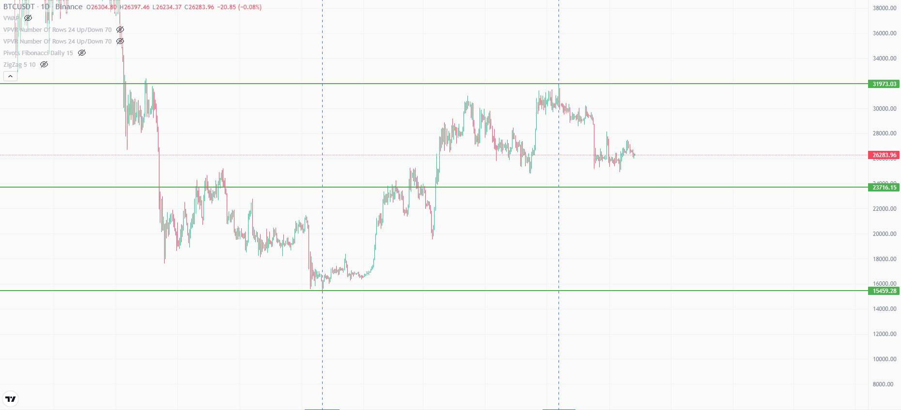
Fibonacci Arc

Slide 10
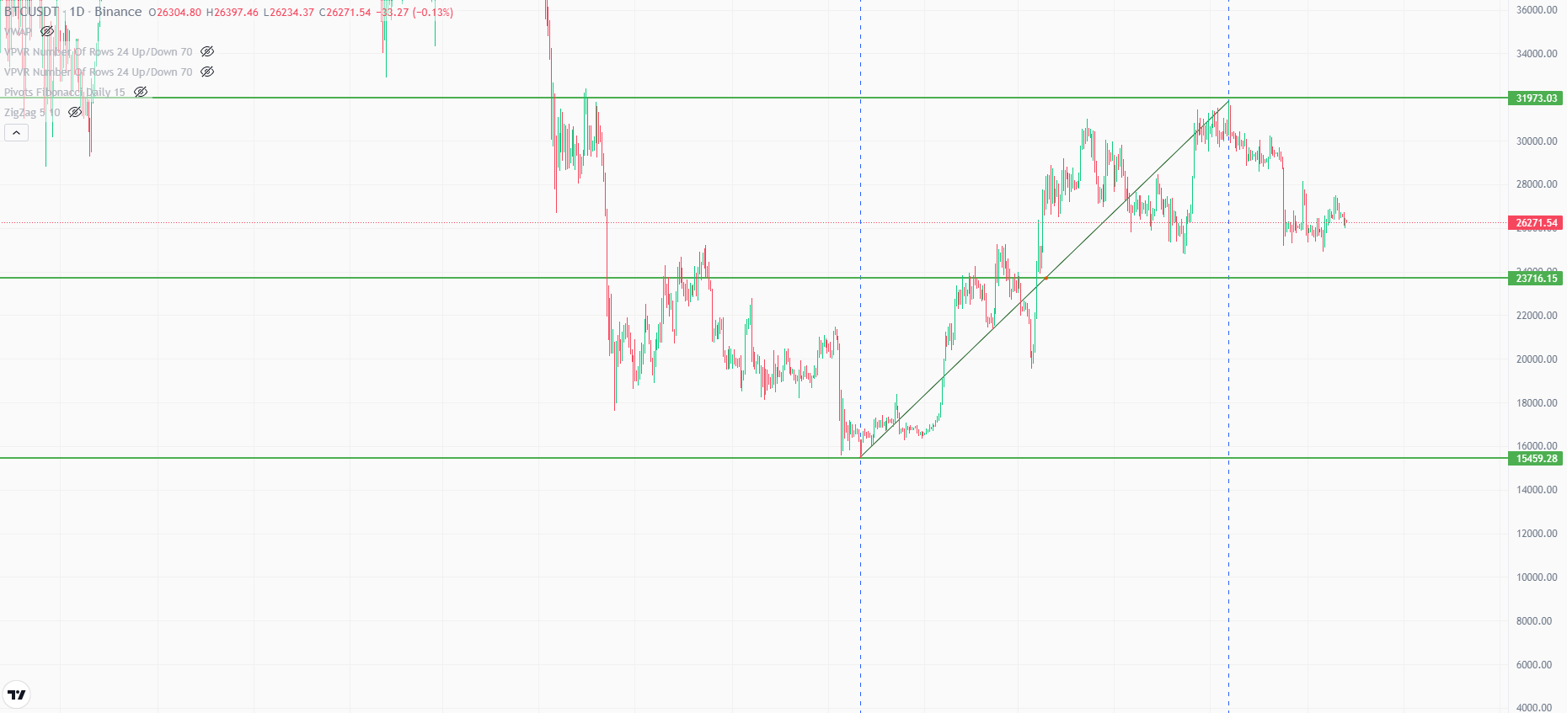
Fibonacci Arc

Slide 11
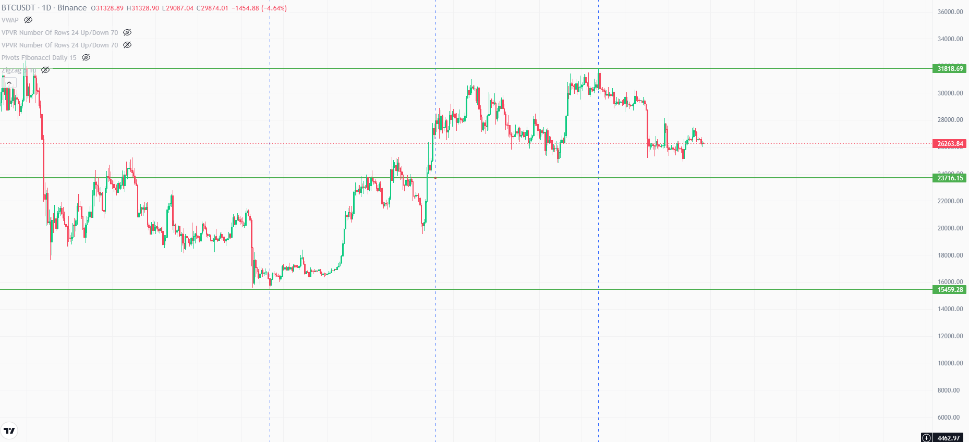
Fibonacci Arc

Slide 12
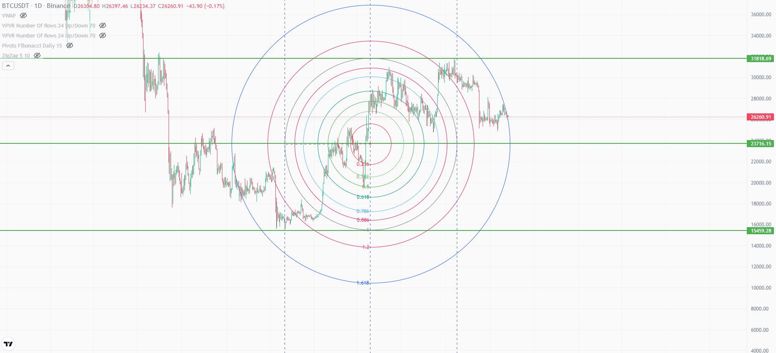
Fibonacci Arc

Slide 13
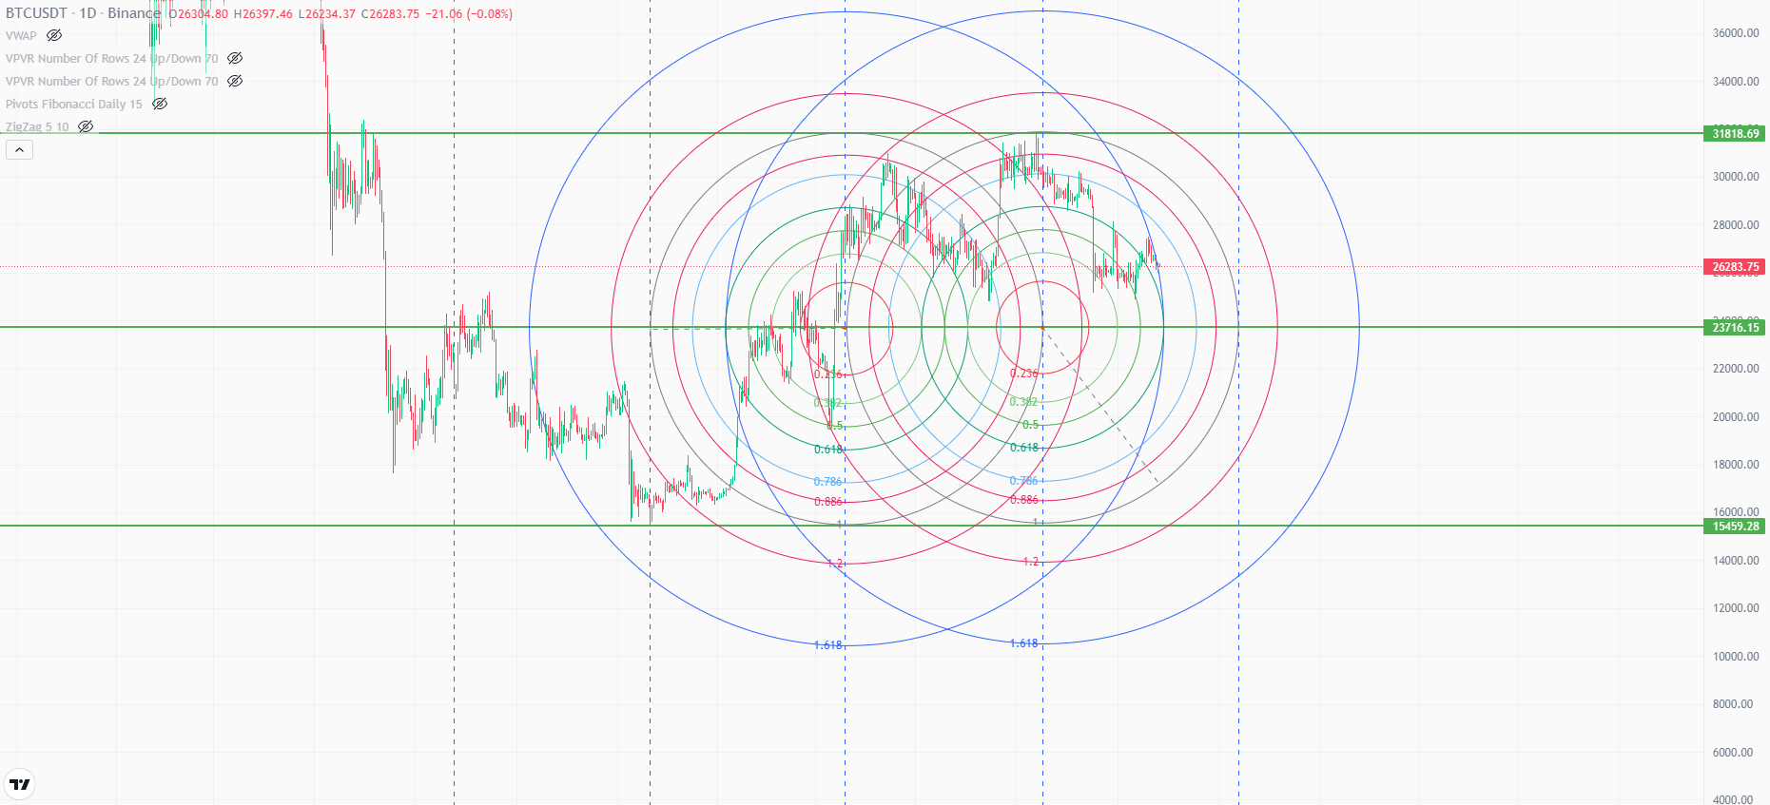
Fibonacci Arc

